Slide 1
Relations
Definition: Let A and B be sets. A binary relation from A to B is a subset of A×B.
In other words, for a binary relation R we have R ⊆ A×B. We use the notation aRb to denote that (a, b)∈R and aRb to denote that (a, b)∉R.
If we want to describe a relationship between elements of two sets A and B, we can use ordered pairs with their first element taken from A and their second element taken from B.
Since this is a relation between two sets, it is called a binary relation.

Slide 2
Relations on a Set
Definition: A relation on the set A is a relation from A to A.
In other words, a relation on the set A is a subset of A×A.
Example: Let A = {1, 2, 3, 4}. Which ordered pairs are in the relation R = {(a, b) | a < b}

Slide 3
Relations on a Set
1
1
R
1
2
3
4
1
X
X
X
2
2
2
X
X
3
3
3
X
4
4
4

Slide 4
Properties of Relations
Reflexive Relation
Irreflexive Relation
Symmetric Relation
Antisymmetric Relation
Asymmetric Relation
Transitive Relations

Slide 5
Properties of Relations
Definition: A relation R on a set A is called reflexive if (a, a)∈R for every element a∈A.
Ex: A = {1, 2, 3, 4}
R = {(1, 1), (2, 2), (2, 3), (3, 3), (4, 4)} is Reflexive
Definition: A relation on a set A is called irreflexive if (a, a) ∉ R for every element a ∈ A.

Slide 6
Properties of Relations
A relation R on a set A is called symmetric if (b, a)∈R whenever (a, b)∈R for all a, b∈A.
A relation R on a set A is called antisymmetric if a = b whenever (a, b)∈R and (b, a)∈R.
A relation R on a set A is called asymmetric if (a, b)∈R implies that (b, a)∉R for all a, b∈A.

Slide 7
Properties of Relations
Properties of Relations
Are the following relations on {1, 2, 3, 4} symmetric, antisymmetric, or asymmetric?
R = {(1, 1), (1, 2), (2, 1), (3, 3), (4, 4)}
symmetric
R = {(1, 1)}
sym. and antisym.
R = {(1, 3), (3, 2), (2, 1)}
antisym. and asym.
R = {(4, 4), (3, 3), (1, 4)}
antisym.

Slide 8
Properties of Relations
Definition: A relation R on a set A is called transitive if whenever (a, b)∈R and (b, c)∈R, then (a, c)∈R for a, b, c ∈ A.
The following relations on {1, 2, 3, 4} are transitive
R = {(1, 1), (1, 2), (1,4),(2,4),(2, 2), (2, 1), (3, 3), (4,4)}.

Slide 9
Equivalence Relation
Let E be a relation on set A.
E is an equivalence relation if & only if it is:
Reflexive
Symmetric
Transitive.
Examples
a E b when a ≡ b ( mod 5 ). (Over N)

Slide 10
Equivalence Relation
Let us assume that R be a relation on the set of ordered pairs of positive integers such that ((a,b), (c,d))∈ R if and only if ad=bc. Is R an equivalence relation?
In order to prove that R is an equivalence relation, we must show that R is reflexive, symmetric and transitive.

Slide 11
Equivalence Relation
Reflexive Property
According to the reflexive property, if (a, a) ∈ R, for every a∈A
For all pairs of positive integers,
((a,b),(a,b))∈ R.
Clearly, we can say
ab = ab for all positive integers.
Hence, the reflexive property is proved.

Slide 12
Equivalence Relation
Symmetric Property
From the symmetric property,
if (a, b) ∈ R, then we can say (b, a) ∈ R
For the given condition,
if ((a,b),(c,d)) ∈ R, then ((c,d),(a,b)) ∈ R.
If ((a,b),(c,d))∈ R, then ad = bc and cb = da
since multiplication is commutative.
Therefore ((c,d),(a,b)) ∈ R
Hence symmetric property is proved.

Slide 13
Equivalence Relation
Transitive Property
From the transitive property,
if (a, b) ∈ R and (b, c) ∈ R, then (a, c) also belongs to R
For the given set of ordered pairs of positive integers,
((a,b), (c,d))∈ R and ((c,d), (e,f))∈ R,
then ((a,b),(e,f) ∈ R.
Now, assume that ((a,b), (c,d))∈ R and ((c,d), (e,f)) ∈ R.
Then we get, ad = cb and cf = de.
The above relation implies that a/b = c/d and that c/d = e/f,
so a/b = e/f we get af = be.
Therefore ((a,b),(e,f))∈ R.
Hence transitive property is proved.

Slide 14
Equivalence Relation
Example: Let A = {1, 2, 3, 4} and R = {(1, 1), (1, 3), (2, 2), (2, 4), (3, 1), (3, 3), (4, 2), (4, 4)}.
Show that R is an Equivalence Relation.
Solution:
Reflexive: Relation R is reflexive as (1, 1), (2, 2), (3, 3) and (4, 4) ∈ R.
Symmetric: Relation R is symmetric because whenever (a, b) ∈ R, (b, a) also belongs to R.
Example: (2, 4) ∈ R ⟹ (4, 2) ∈ R.
Transitive: Relation R is transitive because whenever (a, b) and (b, c) belongs to R, (a, c) also belongs to R.
Example: (2, 4), (4, 2) ∈ R ⟹ (2, 2) ∈ R

Slide 15
Partial Order Relations
A relation R on a set A is called a partial order relation if it satisfies the following three properties:
Relation R is Reflexive, i.e. aRa ∀ a∈A.
Relation R is Antisymmetric, i.e., aRb and bRa ⟹ a = b.
Relation R is transitive, i.e., aRb and bRc ⟹ aRc.

Slide 16
Partial Order Relations
Example1: Show whether the relation (x, y) ∈ R, if, x ≥ y defined on the set of +ve integers is a partial order relation.
Solution: Consider the set A = {1, 2, 3, 4} containing four +ve integers. Find the relation for this set such as R = {(2, 1), (3, 1), (3, 2), (4, 1), (4, 2), (4, 3), (1, 1), (2, 2), (3, 3), (4, 4)}.
Reflexive: The relation is reflexive as for every a ∈ A. (a, a) ∈ R, i.e. (1, 1), (2, 2), (3, 3), (4, 4) ∈ R.
Antisymmetric: The relation is antisymmetric as whenever (a, b) and (b, a) ∈ R, we have a = b.
Transitive: The relation is transitive as whenever (a, b) and (b, c) ∈ R, we have (a, c) ∈ R.

Slide 17
Partial Order Relations
Example2: Show that the relation 'Divides' defined on N is a partial order relation.
Solution:
Reflexive: We have a divides a, ∀ a∈N. Therefore, relation 'Divides' is reflexive.
Antisymmetric: Let a, b, c ∈N, such that a divides b. It implies b divides a iff a = b. So, the relation is antisymmetric.
Transitive: Let a, b, c ∈N, such that a divides b and b divides c.

Slide 18
Partial Order Relations
Partial Order Set (POSET):
The set A together with a partial order relation R on the set A and is denoted by (A, R) is called a partial orders set or POSET.
Total Order Relation:
Consider the relation R on the set A. If it is also called the case that for all, a, b ∈ A, we have either (a, b) ∈ R or (b, a) ∈ R or a = b, then the relation R is known total order relation on set A.
Example: Show that the relation '<' (less than) defined on N, the set of +ve integers is neither an equivalence relation nor partially ordered relation but is a total order relation.
Solution:
Reflexive: Let a ∈ N, then a < a ⟹ '<' is not reflexive.
As, the relation '<' (less than) is not reflexive, it is neither an equivalence relation nor the partial order relation.
But, as ∀ a, b ∈ N, we have either a < b or b < a or a = b. So, the relation is a total order relation.

Slide 19
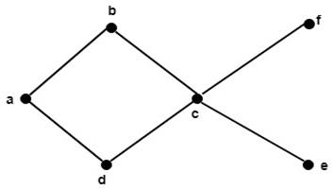
Partial Order Relations
Elements of POSET:
Maximal Element: An element a ∈ A is called a maximal element of A if there is no element in c in A such that a ≤ c.
Minimal Element: An element b ∈ A is called a minimal element of A if there is no element in c in A such that c ≤ b.
Example: Determine all the maximal and minimal elements of the poset whose Hasse diagram is shown in fig:
Solution: The maximal elements are b and f.
The minimal elements are d and e.

Slide 20
Hasse Diagrams
It is a useful tool, which completely describes the associated partial order. Therefore, it is also called an ordering diagram. It is very easy to convert a directed graph of a relation on a set A to an equivalent Hasse diagram. Therefore, while drawing a Hasse diagram following points must be remembered.
The vertices in the Hasse diagram are denoted by points rather than by circles.
Since a partial order is reflexive, hence each vertex of A must be related to itself, so the edges from a vertex to itself are deleted in Hasse diagram.
Since a partial order is transitive, hence whenever aRb, bRc, we have aRc. Eliminate all edges that are implied by the transitive property in Hasse diagram, i.e., Delete edge from a to c but retain the other two edges.
If a vertex 'a' is connected to vertex 'b' by an edge, i.e., aRb, then the vertex 'b' appears above vertex 'a'. Therefore, the arrow may be omitted from the edges in the Hasse diagram.
The Hasse diagram is much simpler than the directed graph of the partial order.

Slide 21
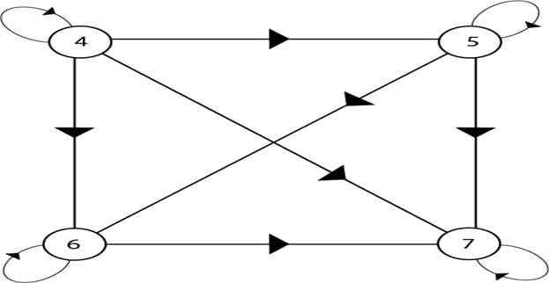
Hasse Diagrams
Example: Consider the set A = {4, 5, 6, 7}. Let R be the relation ≤ on A. Draw the directed graph and the Hasse diagram of R.
Solution: The relation ≤ on the set A is given by
R = {{4, 5}, {4, 6}, {4, 7}, {5, 6}, {5, 7}, {6, 7}, {4, 4}, {5, 5}, {6, 6}, {7, 7}}
The directed graph of the relation R is as shown in fig:

Slide 22

Hasse Diagrams
To draw the Hasse diagram of partial order, apply the following points:
Delete all edges implied by reflexive property i.e. (4, 4), (5, 5), (6, 6), (7, 7)
Delete all edges implied by transitive property i.e. (4, 7), (5, 7), (4, 6)
Replace the circles representing the vertices by dots.
Omit the arrows.
The Hasse diagram is as shown in fig:

Slide 23
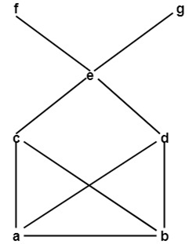
Hasse Diagrams
Upper Bound: Consider B be a subset of a partially ordered set A. An element x ∈ A is called an upper bound of B if y ≤ x for every y ∈ B.
Lower Bound: Consider B be a subset of a partially ordered set A. An element z ∈ A is called a lower bound of B if z ≤ x for every x ∈ B.
Example: Consider the poset A = {a, b, c, d, e, f, g} be ordered shown in fig. Also let B = {c, d, e}. Determine the upper and lower bound of B.
Solution:
The upper bound of B is e, f, and g because every element of B is '≤‘
e, f, and g.
The lower bounds of B are a and b because a and b are '≤' every elements of B.

Slide 24
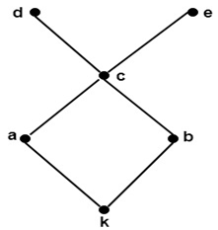
Hasse Diagrams
Least Upper Bound (SUPREMUM):
Let A be a subset of a partially ordered set S. An element M in S is called an upper bound of A if M succeeds every element of A, i.e. if, for every x in A, we have x <=M
If an upper bound of A precedes every other upper bound of A, then it is called the supremum of A and is denoted by Sup (A)
Greatest Lower Bound (INFIMUM):
An element m in a poset S is called a lower bound of a subset A of S if m precedes every element of A, i.e. if, for every y in A, we have m <=y
If a lower bound of A succeeds every other lower bound of A, then it is called the infimum of A and is denoted by Inf (A)
Example: Determine the least upper bound and greatest lower bound of B = {a, b, c} if they exist, of the poset whose Hasse diagram is shown in fig:
Solution: The least upper bound is c.
The greatest lower bound is k.

Slide 25
Lattices
Let L be a non-empty set closed under two binary operations called meet and join, denoted by ∧ and ∨. Then L is called a lattice if the following axioms hold where a, b, c are elements in L:
1) Commutative Law: - (a) a ∧ b = b ∧ a (b) a ∨ b = b ∨ a
2) Associative Law:- (a) (a ∧ b)∧ c = a ∧(b∧ c) (b) (a ∨ b) ∨ c = a ∨ (b ∨ c)
3) Absorption Law: - (a) a ∧ ( a ∨ b) = a (b) a ∨ ( a ∧ b) = a
Duality:
The dual of any statement in a lattice (L,∧ ,∨ ) is defined to be a statement that is obtained by interchanging ∧ an ∨.
For example, the dual of a ∧ (b ∨ a) = a ∨ a is a ∨ (b ∧ a )= a ∧ a

Slide 26
Closure
Closure:
Definition: The closure of a relation R with respect to property P is the relation obtained by adding the minimum number of ordered pairs to R to obtain property P.
In terms of the digraph representation of R
To find the reflexive closure - add loops.
To find the symmetric closure - add arcs in the opposite direction.
To find the transitive closure - if there is a path from a to b, add an arc from a to b.
Note: Reflexive and symmetric closures are easy. Transitive closures can be very complicated.

Slide 27
Closure Properties of Relations
Consider a given set A, and the collection of all relations on A. Let P be a property of such relations, such as being symmetric or being transitive. A relation with property P will be called a P-relation. The P-closure of an arbitrary relation R on A, indicated P (R), is a P-relation such that
R ⊆ P (R) ⊆ S
(1) Reflexive and Symmetric Closures: The next theorem tells us how to obtain the reflexive and symmetric closures of a relation easily.
Theorem: Let R be a relation on a set A. Then:
R ∪ ∆A is the reflexive closure of R
R ∪ R-1 is the symmetric closure of R.

Slide 28
Closure Properties of Relations
Transitive Closures: Consider a relation R on a set A. The transitive closure R of a relation R of a relation R is the smallest transitive relation containing R.
Recall that R2 = R◦ R and Rn = Rn-1 ◦ R. We define
The following Theorem applies:
Theorem1: R* is the transitive closure of R
Suppose A is a finite set with n elements.
R* = R ∪R2 ∪.....∪ Rn
Theorem 2: Let R be a relation on a set A with n elements. Then
Transitive (R) = R ∪ R2∪.....∪ Rn

Slide 29
Closure Properties of Relations
Example1: Consider the relation R = {(1, 2), (2, 3), (3, 3)} on A = {1, 2, 3}. Then R2 = R◦ R = {(1, 3), (2, 3), (3, 3)} and R3 = R2 ◦ R = {(1, 3), (2, 3), (3, 3)} Accordingly, Transitive (R) = {(1, 2), (2, 3), (3, 3), (1, 3)}

Slide 30
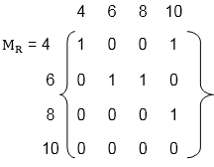
Closure Properties of Relations
Example2: Let A = {4, 6, 8, 10} and R = {(4, 4), (4, 10), (6, 6), (6, 8), (8, 10)} is a relation on set A. Determine transitive closure of R.
Solution: The matrix of relation R is shown in fig:

Slide 31
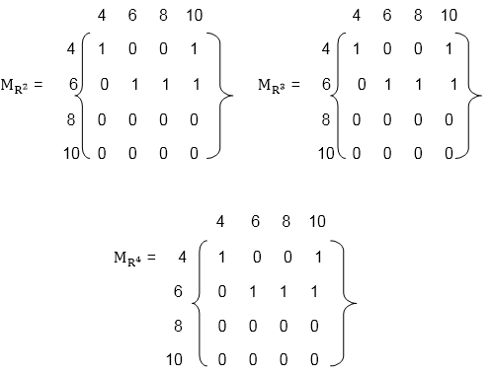
Closure Properties of Relations
Now, find the powers of M_{R} as in fig:
Hence, the transitive closure of M_{R} is M_{R}* as shown in Fig (where M_{R}* is the ORing of a power of M_{R}).

Slide 32
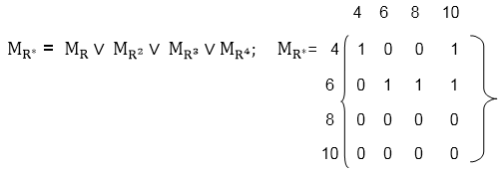
Closure Properties of Relations
Hence, the transitive closure of M_{R} is M_{R}* as shown in Fig (where M_{R}* is the ORing of a power of M_{R}).
Thus,
R* = {(4, 4), (4, 10), (6, 8), (6, 6), (6, 10), (8, 10)}.

Slide 33
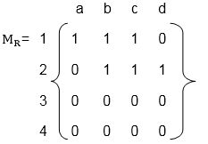
Representation of Relations
Relations can be represented in many ways:
1. Relation as a Matrix: Let P = [a₁,a₂,a₃,.......a_{m}] and Q = [b₁,b₂,b₃......b_{n}] are finite sets, containing m and n number of elements respectively. R is a relation from P to Q. The relation R can be represented by m x n matrix M = [M_{ij}], defined as M_{ij} = 0 if (a_{i},b_{j}) ∉ R 1 if (a_{i},b_{j} )∈ R
Example
Let P = {1, 2, 3, 4}, Q = {a, b, c, d}
and R = {(1, a), (1, b), (1, c), (2, b), (2, c), (2, d)}.
The matrix of relation R is shown as fig:

Slide 34
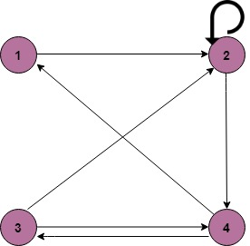
Representation of Relations
2. Relation as a Directed Graph: There is another way of picturing a relation R when R is a relation from a finite set to itself.
Example
A = {1, 2, 3, 4}
R = {(1, 2) (2, 2) (2, 4) (3, 2) (3, 4) (4, 1) (4, 3)}

